Slide 1
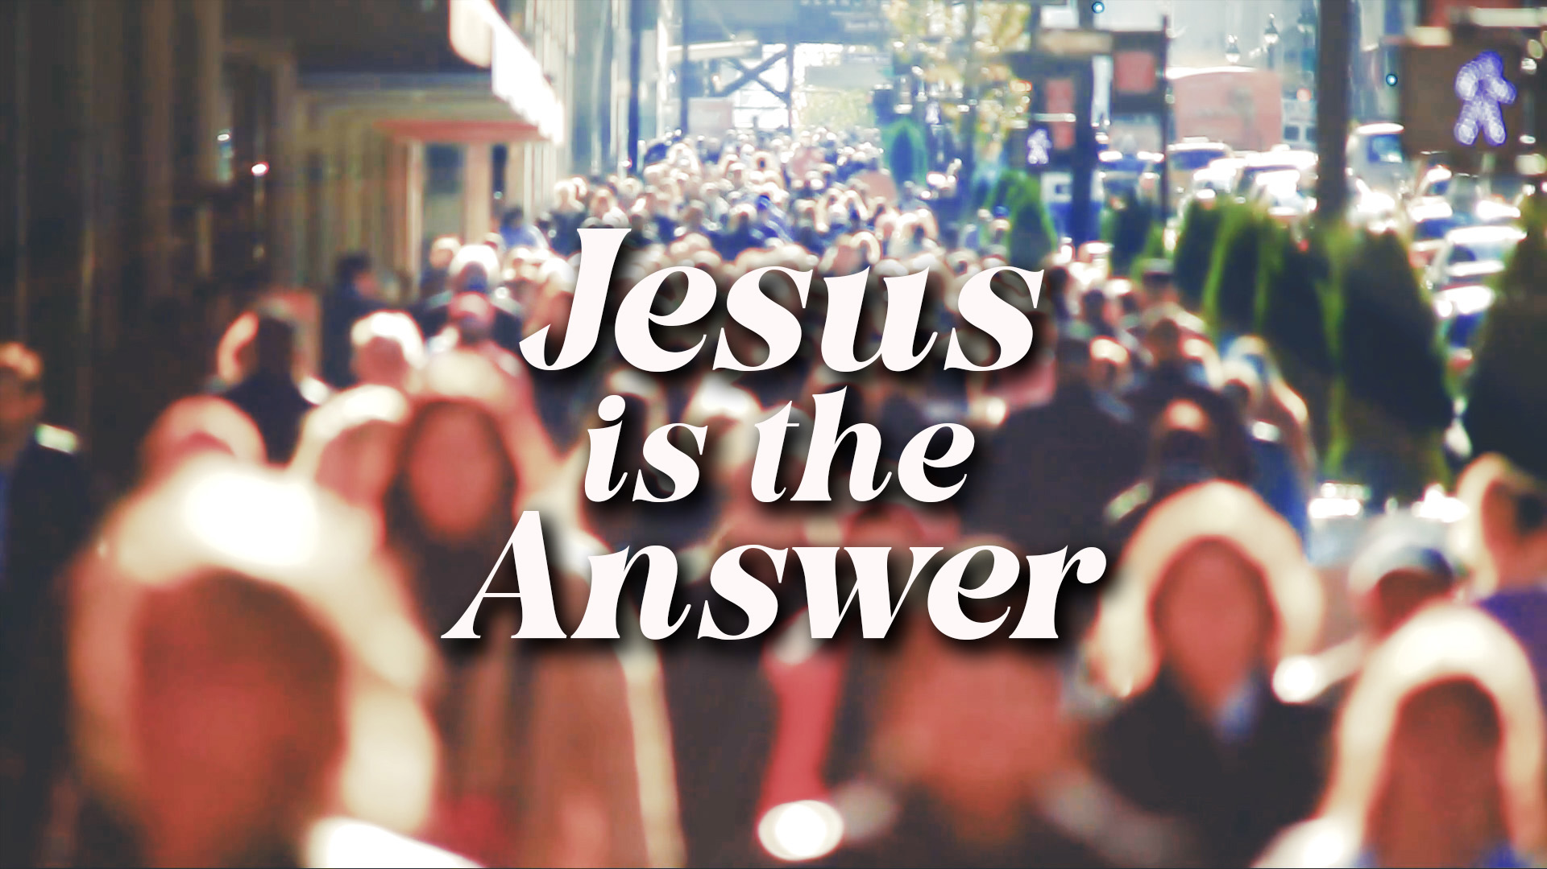
WHO’S GOT THE RIZZ?
20240303

Slide 2
Welcome to our series, Jesus is the Answer.
During this four-week series we’ll be looking at
4 major themes in 1 Corinthians that Paul addresses
and how Jesus provides the new perspective or answer to them.
Week 1 is about Divisions in the church. (1 Corinthians 1-4).
Church is not a popularity contest
where we pick our favourite teacher or ministry.
Church is a community of people centered around Jesus.
One of the images Paul uses to describe this community is family.
Because of the resurrection we are a family,
unified around our resurrected Jesus.
Through God’s power we can have the mind of Christ
and promote unity in the church.

Slide 3
Working Towards Unity
Over the years I’ve had opportunity to work with
many teams in the church.
Most of the teams I’ve been part of have been unified in our vision
for what we want to accomplish and our individual roles.
Some of the teams have struggled with being unified.
We’ve had to work to try to be unified.
What about you? Have you been part of a unified team?
Have you been part of a team that had to work harder to be unified?
How did it go?
Share your story with the group.

Slide 4
WATCH: To begin your LifeGroup study,
watch the Bible Project summary of 1 Corinthians.
https://www.youtube.com/watch?v=yiHf8klCCc4&t=3s

Slide 5
Being in community can get COMPLEX
² To the church of God in Corinth, to those sanctified in Christ Jesus and called to be his holy people, together with all those everywhere who call on the name of our Lord Jesus Christ—their Lord and ours:
1 Corinthians 1:2 NIV
In our effort to be the community of Christ,
why is it important to remember who we are?

Slide 6
Our goal in community is to be UNITED
¹⁰ I appeal to you, brothers and sisters,^{[a]} in the name of our Lord Jesus Christ, that all of you agree with one another in what you say and that there be no divisions among you, but that you be perfectly united in mind and thought.
1 Corinthians 1:10 NIV
What does it mean to be
“perfectly united in mind and thought”?
- Where have you seen this kind of unity?
Where have you seen the opposite?

Slide 7
God’s Spirit (not our smarts) UNITES us
And so it was with me, brothers and sisters. When I came to you, I did not come with eloquence or human wisdom as I proclaimed to you the testimony about God.^{[a]} ² For I resolved to know nothing while I was with you except Jesus Christ and him crucified. ³ I came to you in weakness with great fear and trembling. ⁴ My message and my preaching were not with wise and persuasive words, but with a demonstration of the Spirit’s power …
1 Corinthians 2:1-4 NIV
Paul says,
“My message and my preaching were not with wise and persuasive words …”.
But, clearly Paul did use wise and persuasive words in what he wrote.
What point do you think he is trying to make here?

Slide 8
Being OPEN to the Spirit is key to unity
Read back through 1 Corinthians chapter 2.
Where do you see the Spirit mentioned?
How does this tie back to our previous series, Open to the Spirit?

Slide 9
READ: 1 Corinthians 3:3-9
The Corinthians were quarreling over which leader they each followed.
This led to disunity.
Why do you think they did this? Why might we do this today?
Paul shows the Corinthians that rather than choosing favourites,
they should remember that each leader has a unique role to play
and that God is the one who works through us.
How is this helpful in promoting unity?

Slide 10
Don’t DESTROY the church
¹⁶ Don’t you know that you yourselves are God’s temple
and that God’s Spirit dwells in your midst?
¹⁷ If anyone destroys God’s temple, God will destroy that person;
for God’s temple is sacred, and you together are that temple.
1 Corinthians 3:16-17 NIV
What does Paul mean – “you yourselves are God’s temple …”?
- Have you ever thought about how God feels about those who
“destroy” the church through creating division, gossip, lies, etc.?
How does this serve as a warning for us today?

Slide 11
Live as HUMBLE SERVANTS
This, then, is how you ought to regard us: as servants of Christ and as those entrusted with the mysteries God has revealed.
1 Corinthians 4:1. NIV
According to this verse, what is Paul’s solution
to the problem of divisions in the church?

Slide 12
“Therefore I urge you to imitate me.” 1 Corinthians 4:16
Note that Paul tells the Corinthians, “imitate me.”
READ 1 Corinthians 4:8-15
How does Paul describe what he and the other apostles were like?
How does he contrast their characteristics
with the ambitions of the Corinthians?

Slide 13
Therefore if you have any encouragement from being united with Christ, if any comfort from his love, if any common sharing in the Spirit, if any tenderness and compassion, ² then make my joy complete by being like-minded, having the same love, being one in spirit and of one mind. ³ Do nothing out of selfish ambition or vain conceit. Rather, in humility value others above yourselves, ⁴ not looking to your own interests but each of you to the interests of the others. ⁵ In your relationships with one another, have the same mindset as Christ Jesus:
Philippians 2:1-5 NIV
What does it look like to live
as humble servants in the church today?

Slide 14
PRAYER:
Spend some time thanking God for the example of Jesus,
our humble servant-king.
Ask God to help you to grow to have the same attitude as Jesus,
to live as a humble servant,
to promote unity in his church.

