Slide 1
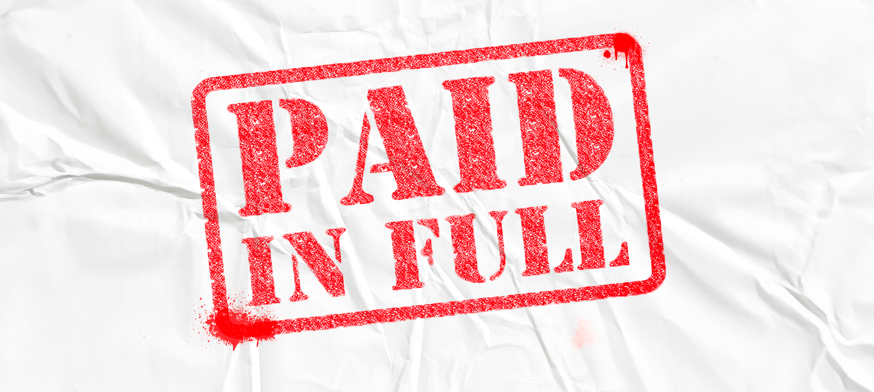
20240225

Slide 2
Welcome to our LifeGroup study, PAID IN FULL.
On this date we are celebrating two amazing things God has done.
First, we are celebrating that the mortgage
on our church building and property in Waterloo is PAID IN FULL.
This celebration is an incredible testimony to our God who has
provided through the generous hearts of many Creeksiders.
The second celebration today is those who are being baptized.
Each baptism story is a testimony pointing to Jesus, our Redeemer,
who has PAID IN FULL the debt we owed for our sin.
For our LifeGroup study today, we’ll explore what it means to us
that Jesus has redeemed us, that our debt has been PAID IN FULL.

Slide 3
IT’S PAID FOR
About 3 years ago our family went out to a restaurant
that was recommended to us by a friend.
Our dining experience that evening was among the best we have had.
It was an incredible meal and the service was excellent.
At the end of the evening, the manager of the restaurant
came to our table and said, “Your meal has been paid for.”
We were blown away! This was an unexpected and wonderful gift.
How about you? Have you ever had someone say to you – “It’s paid for”?
Or, have you covered the cost for someone?
Share your story with the group!

Slide 4
I owed a DEBT I could not pay.
²³ For everyone has sinned; we all fall short of God’s glorious standard. Romans 3:23 NLT
- What does it mean that
“we all fall short of God’s glorious standard”?
- Why is it important that we measure ourselves
by God’s standard and not our own?

Slide 5
I owed a DEBT I could not pay.
Listen! The Lord’s arm is not too weak to save you,
nor is his ear too deaf to hear you call.
² It’s your sins that have cut you off from God.
Because of your sins,
he has turned away and will not listen anymore.
Isaiah 59:1-2 NLT
How do these verses speak to our need to be redeemed?

Slide 6
I owed a DEBT I could not pay.
³⁴ Jesus replied, “Very truly I tell you,
everyone who sins is a slave to sin.
John 8:34 NIV
Every one of us is a “slave” to sin.
How does this speak to our need to be redeemed?

Slide 7
Jesus, my Redeemer, has PAID my debt.
¹³ Christ paid the price to free us from the curse that the laws
in Moses’ Teachings bring by becoming cursed instead of us.
Scripture says, “Everyone who is hung on a tree is cursed.”
¹⁴ ⌞Christ paid the price⌟ so that the blessing promised to Abraham
would come to all the people of the world through Jesus Christ
and we would receive the promised Spirit through faith.
Galatians 3:13-15 GOD’S WORD translation
According to verse 13, what did Jesus become to redeem us?
- These verses tell us that Jesus paid the price for us. How did He do this?
- What was the blessing promised to Abraham?

Slide 8
Part of the Gospel message is “PAID IN FULL”.
“The gospel of Jesus Christ is that all who believe in him are bought with a price. They will never come into condemnation. The judgment day is past. It was 2,000 years ago. When Jesus died, the debt was paid. Justice has been done. We are free. And God is not against us but for us, if we will accept his gift and trust him.” John Piper
How does this quote help you understand the Gospel message, “PAID IN FULL”?

Slide 9
²³ For the wages of sin is death,
but the gift of God is eternal life in^{[a]} Christ Jesus our Lord.
The Gospel message is found in the little word “but”.
Why is the word “but” so important?
- How might you respond to someone who says,
“You don’t know what I’ve done.
I can never be forgiven by God.”?

Slide 10
With all my heart I commend to you the infinitely valuable Jesus Christ. He is the Father's full and sufficient price for sinners. If you receive him, then from this day forward every time your conscience dredges up the sin of the past and says, "You will pay!" you will be able to say, "God has already paid. I have been bought with a price." John Piper
How does the quote encourage you
that your debt has been “PAID IN FULL”?

Slide 11
I’ve been REDEEMED.
But now, this is what the Lord says—
he who created you, Jacob, he who formed you, Israel:
“Do not fear, for I have redeemed you;
I have summoned you by name; you are mine.
Isaiah 43:1 NIV
They will be called the Holy People, the Redeemed of the Lord;
and you will be called Sought After, the City No Longer Deserted.
Isaiah 62:12 NIV
- How do these verses encourage you
that your debt has been paid in full?

Slide 12
PRAYER
Spend some time together in group thanking God
that your debt has been PAID IN FULL.
Ask Him to help you to live in the freedom He has purchased for you.

