Slide 1
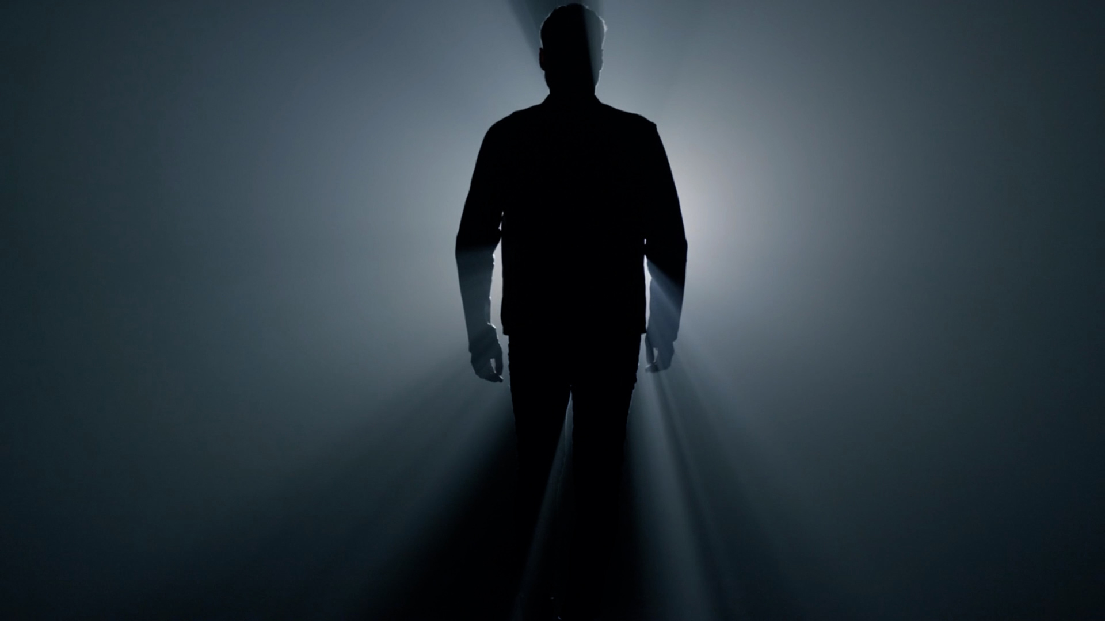
LifeGroup Study
Week 4: “Why do you call me Lord
and don’t do what I say?”

Slide 2
Welcome back to our series, ‘This Question is FOR YOU”!
In this series we are exploring 4 questions Jesus asks us.
These questions Jesus asks are designed to
get us thinking about who Jesus is and how we can follow him well.
Today’s question is –
"Why do you call me ‘Lord, Lord’ and do not do what I say?" (Luke 6:46).
As followers of Jesus, it is important to not only profess our faith,
but to also live it out in our daily actions.
This includes obeying Jesus' teachings, as well as striving
to be more like him in our character and behavior.
Is there anything you're delaying being obedient about?
Allow today’s study to speak to your heart
about next steps you can take to obey and follow Jesus.

Slide 3
That Teacher Was Tough, But Effective!
When I was in grade 7 I had a teacher who was particularly tough.
This teacher had stern warnings for those
who wanted to play around rather than study.
Our teacher was tough, but effective!
What about you?
What teacher do you remember who was tough but effective?
Or maybe you remember a teacher who was tough but not effective! ☺
Share your story with the group!

Slide 4
Jesus is a Master at using parables to teach us important truths.
He does this for today’s question –
“Why do you call me ‘Lord’ and don’t do what I say?”
To get us to think about our response to his question,
Jesus tells us the parable of two trees.
Let’s dig into this parable and ask ourselves,
“What is my response to Jesus?”

Slide 5
READ: Matthew 21:18-19 and Luke 6:43-45
What do you notice about what’s happening with the trees in these passages? Write down or make note of everything you observe.
Think about the tree in Matthew 21:18-19.
How might this tree be a picture of not doing what Jesus says?

Slide 6
In Luke 6:45 we read that a good person
produces good fruit based on what is in the person’s heart.
What are some examples of good fruit?

Slide 7
Think again about Jesus’ teaching in Luke 6:43.
Jesus says, “No good tree produces bad fruit …”.
What are examples of bad fruit?

Slide 8
Think again about Jesus’ teaching in Luke 6:43.
Jesus says, “No good tree produces bad fruit …”.
What are examples of bad fruit?

Slide 9
READ: Matthew 7:15-23. A Tree and Its Fruit
In vs. 16 we read, “By their fruit you will recognize them.”
How does this apply to the church today?
How does it apply to you?

Slide 10
The passage in Matthew 7 is a warning from Jesus
to be aware of false prophets.
How might we know someone is a false prophet today?

Slide 11
In Matthew 7:21, Jesus says,
“Not everyone who says to me, ‘Lord, Lord,’
will enter the kingdom of heaven,
but only the one who does the will of my Father who is in heaven.”
What kind of person is Jesus warning about here?

Slide 12
READ the words to the hymn
Trust and Obey
When we walk with the Lord
in the light of his word,
what a glory he sheds on our way!
While we do his good will,
He abides with us still,
and with all who will trust and obey.
Trust and obey, for there’s no other way
to be happy in Jesus, but to trust and obey.

Slide 13
Trust and Obey
How does trusting God factor into obeying him?
Do you agree with the chorus of this hymn, that the only way to be happy in this life is by doing what Jesus says? Why or why not?
How do these words encourage you in doing what Jesus says?

Slide 14
In what way are you struggling to obey these days?
How can your group pray for you?

Slide 15
PRAY
Read the final verse of the hymn, Trust and Obey,
and then spend some time thanking God for his grace
and guidance in your life to follow Jesus and do what he says.
Then in fellowship sweet
we will sit at his feet,
or we’ll walk by his side in the way;
What he says we will do,
where he sends we will go;
never fear, only trust and obey.
Trust and obey, for there’s no other way
to be happy in Jesus, but to trust and obey.

