Slide 1
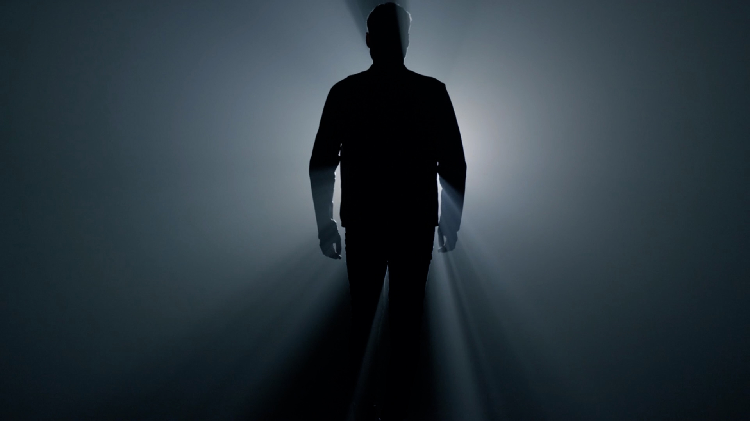
LifeGroup Study
Week 2: What Do You Want Me to Do for You?

Slide 2
Welcome back to our series, ‘This Question is FOR YOU”!
In this series we are exploring 4 questions Jesus asks us.
These questions Jesus asks are designed to get us thinking about who Jesus is and how we can follow him well.
Today’s question is – What do you want me to do for you?
In asking us what we want him to do for us,
Jesus is inviting us to express our deepest needs and desires.
This question can also be seen as a call to trust in Jesus
and believe that he has the power to meet our needs.
As believers, we should be willing to bring our needs and desires to Jesus in prayer.
We should also be open to accepting his will and trusting
that he knows what is best for us, even if it may not be what we initially desire.
Today’s question teaches us to expect to
experience his grace and blessing in our lives.

Slide 3
I Had a Dream!
Think back to when you were a kid, or maybe your years as a young adult.
What did you dream about your future?
Did you dream about who you would be, like maybe an athlete or artist?
Did you dream about where you would live and what your life would be like?
Share your dream with the group!

Slide 4
For the first part of our study, we’ll explore the story of Jesus’ encounter with a paralyzed man at the Pool of Bethesda.
As you read this story, consider how Jesus’
question prompts you to consider your answer.
Do I truly desire Jesus’ healing and transformation in my life?

Slide 5
READ John 5:1-9 Jesus Asks a Paralytic – Do You Want to Be Healed?
What are your initial thoughts and reactions to this account?
What stands out to you? What questions to you have?
Why do you think Jesus approached this particular man?
What does this tell us about Jesus’ desire for our lives?

Slide 6
In verse 6, Jesus asks the man, "Do you want to be healed?"
What might be some reasons why
the man would hesitate to say “yes”?

Slide 7
In verse 7, instead of a clear "yes" or "no,"
the man offers an excuse for why he hasn't been healed yet.
How might we be like this man,
offering excuses or justifications for why we aren't experiencing
the healing or transformation we desire in our own lives?
Sometimes our baggage and disfunctions become strange comforts to us.
Is it possible that sometimes we are actually comfortable in our discomfort?

Slide 8
When the man does finally get up and walk,
he does so without knowing who Jesus is (v. 13-14).
It's not until later that he learns
that the one who healed him is the Son of God (v. 15).
How might this inform our understanding
of what it means to have faith in God's healing power?

Slide 9
Sometimes what we want is tempered by what we believe.
For example, we don’t often desire the impossible
because we don’t believe God can miraculously work in our lives.
What might help you trust that Jesus can bring good,
seemingly impossible, lasting change to your life?

Slide 10
Think about a situation in your life where you feel "stuck" or in need of healing.
It might be a physical ailment, a pattern of behavior or thinking,
a relationship, or a spiritual struggle.
In light of this story, ask yourself honestly:
do you want to be healed? Why or why not?
What might you be holding onto that is preventing you
from experiencing the transformation you desire?

Slide 11
Reflect on the idea that Jesus asks us to investigate our desires.
What do we want, and why do we want it?
How might our desires be influenced by our past experiences,
our fears, or our beliefs about ourselves and the world?
How can we discern which desires are healthy and which ones
might be holding us back from experiencing
the fullness of life that God desires for us?

Slide 12
PRAY
Father, thank You for being a God who loves us.
Thank You for your plan for our lives.
Today we have been thinking about Jesus’ question
– “Do you want to be healed?”
We’ve learned that your plan for us is to heal and transform our lives.
Help us to see areas in our lives
where we may be resisting your life-changing power.
Please give us the courage and faith to act
on what we believe about You.
Help us to trust more fully in your power to change us for your glory.
Jesus, help us to know you more and to give ourselves more fully to You.
Thank You for hearing our prayer. AMEN.

