Slide 1
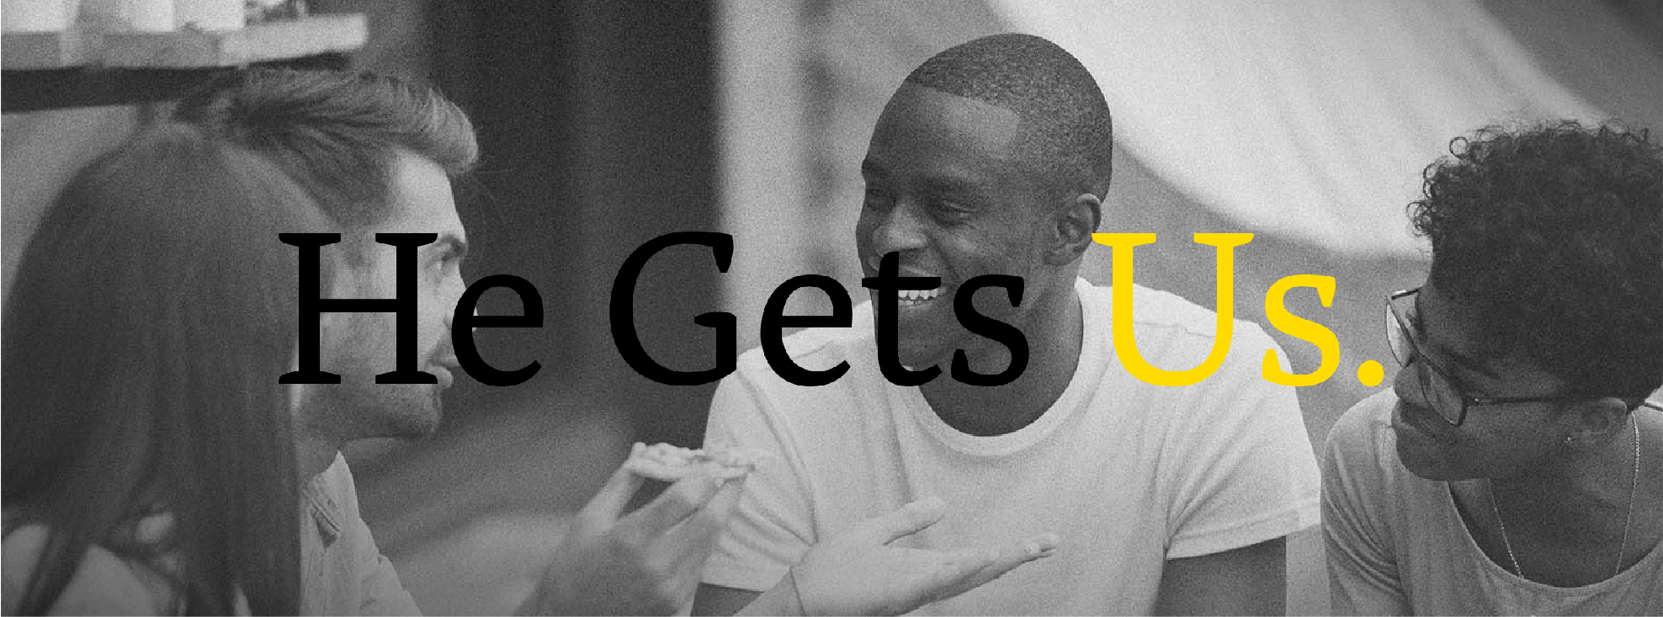
JESUS SUFFERED TOO

Slide 2
OVERVIEW
Welcome back to our series, “He Gets Us”!
Jesus gets our lives because he was human too.
In this series we are exploring how Jesus knows what we’re going through.
He cares and he is able to help you as you trust in him.
For today’s study, we’ll reflect on the suffering of Jesus
and seek to understand the depth of his love and sacrifice for us.
Jesus invites us to offer our own suffering, whether physical or emotional,
to Him. as a way of uniting ourselves with him and his sufferings.
As we seek Jesus we can find comfort and strength in our own suffering.

Slide 3
That Was Tough!
Years ago I helped lead a weekend camping adventure with a youth group. This adventure involved camping in a remote area with no bathroom facilities or place to prepare food. Part way through the weekend we took on a strenuous hike only to discover we had forgotten to pack enough to drink. Overall it was a fun weekend but I must say, that was tough! What memory do you look back on and think – that was tough! Maybe for you it was a challenging task at work, a demanding sport or an adventure that was more than you bargained for.
Share your story with the group!

Slide 4
Jesus Can Relate To Our Suffering Because …
HE SUFFERED WHILE HE WAS HERE ON EARTH
READ Isaiah 52:14, 2 Corinthians 5:21, Philippians 2:6-8
Why did Jesus have to suffer so much while he was here on earth?

Slide 5
Watch this clip of The Chosen: “I am so Tired”
https://www.youtube.com/watch?v=72b4qHPWESw
How does this clip help you understand
how Jesus gets what we suffer in our everyday lives?

Slide 6
Jesus Can Relate To Our Suffering Because …
HE IS STILL A MAN IN A HUMAN BODY
READ John 1:14, Acts 1:9-11, Philippians 3:20-21
What do these verses teach us about
how Jesus is still a man in a human body?

Slide 7
Jesus Can Relate To Our Suffering Because …
HE STILL BEARS HIS SCARS
READ John 20:26-27, Hebrews 2:17-18
Why do you think Jesus would still have scars,
even in his glorified body?

Slide 8
READ Revelation 5:11-12 Worship of the Lamb
In Revelation we repeatedly get the image
of one who looks like a lamb that was slain.
What does it mean to have a king who suffered,
to imagine worshipping a God
who looks like a lamb that was slain?

Slide 9
THE EARLY CHRISTIANS’ VIEW OF SUFFERING
READ
Romans 5:1-5, 8:17-30
1 Peter 2:20-24
Philippians 1:29, 3:10
Revelation 1:9
What do you notice from these verses about
how the early Christians talked about suffering?
How does this differ from how we often talk about suffering?

Slide 10
READ the following quote:
"The truth is that suffering is a terrible thing,
but that there is something worse, something that is the root of all evil:
it is the fact that suffering is often totally wasted."
C.S. Lewis, The Problem of Pain
What do you think of this quote? Do you agree with it? Why or why not?

Slide 11
Is there any suffering you’re currently going through
that you’d like to share with the group?
How do you think God wants to use this suffering
for your good and his glory?

Slide 12
PRAY
Prayer for Someone Who is Suffering
Abba, Father, You are good, good Father, but sometimes this is so hard to see when we are suffocating in misery. Our perspective is so limited and narrow, Father. Help us to surrender control up to You. Today, I pray especially for my friend, that they may experience a deep closeness with You, unlike anything they have known before. Be so real to them. In their suffering, help them to hold on, knowing that You will work even the bad things in life for their good. You have told us that there is time for everything and a season for every activity under the heavens. There is a time to be born and a time to die, a time to weep and a time to laugh, a time to mourn and a time to dance. We are more than conquerors through You who loves us, and nothing in any of these seasons will be able to separate us from the love of You, Father. I rejoice in Your holy name and pray that You fill my friend’s heart with Your unfailing love. In the name of the One who will give us the victor’s crown, Jesus, my King. Amen.
Source - https://connectusfund.org/10-powerful-prayers-for-suffering

