Slide 1
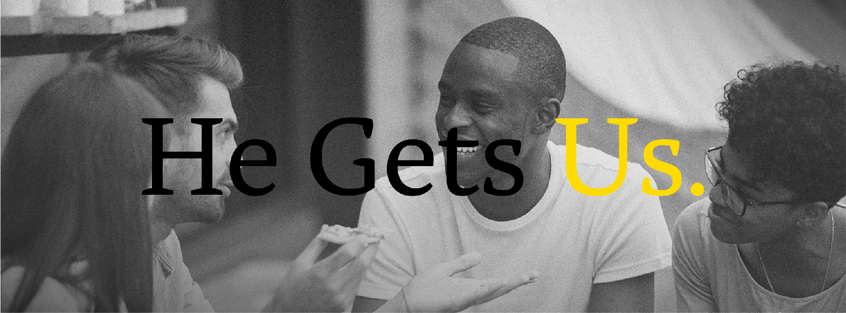
JESUS GOT ANGRY TOO
20230108

Slide 2
OVERVIEW
Welcome to our series, “He Gets Us”! Jesus gets our lives because he was human too. In this series we will explore how Jesus knows what we’re going through. He cares and he is able to help you as you trust in him. Our topic this week is, “Jesus got angry too.” Jesus gets what it's like to look at injustice and be angry. In the temple he flips the tables because the temple had become a "den of thieves" instead of a house of prayer. He also warns against becoming angry in the sermon on the mount (Matt 5:21-26). Are you harbouring anger against someone? Are you posturing your anger as "righteous" that isn't? Is your behaviour around something you're angry about fitting for the situation? Our goal for today is to see our anger as God sees it and invite him to change our unrighteous anger from rage to calm.

Slide 3
Have you ever experienced a time when you felt really angry?
What was the situation and how did you react?

Slide 4
Read Mark 3:1-6 together.
In this passage Jesus is confronted with criticism from the Pharisees.
What do you think Jesus was thinking in this moment?
How does Jesus respond?

Slide 5
Ephesians 4:26-27 instructs:
" ²⁶ “In your anger do not sin”:
Do not let the sun go down while you are still angry,
²⁷ and do not give the devil a foothold.”
What does this passage suggest about the role of anger in our lives?
How might we be able to "be angry and not sin"?
What does it mean to "not let the sun go down on your anger"?
What does it mean to give the devil a foothold?
What practical steps can we take to follow the instructions of this passage?

Slide 6
Read Colossians 3:1-13.
Notice in verse 8 that Paul tells us
to "put off" certain behaviors, including anger.
What does it mean to "put off" anger?
How can we do this?

Slide 7
Read James 1:19-20.
  What does this passage teach us
  about the role of our tongue in relation to anger?
  How might being "slow to anger"
  help us to act in a more righteous way?

Slide 8
Read Proverbs 15:1 and Proverbs 29:11.
• How do these passages encourage us to respond to anger?

Slide 9
Read Matthew 5:21-26 together.
Jesus says that those who are angry with their brother or sister
"will be liable to judgment."
First talk about what you notice about this passage.
What do you think it’s saying?
Why do you think Jesus takes anger towards others so seriously?

Slide 10
Do the passages we’ve discussed so far leave room for us to set
healthy boundaries between us and people
who have hurt us or perpetually make us angry?
If so, what would that look like?

Slide 11
Do you have anyone in your life that you are angry with right now?
Would you be willing to tell the group so that we can pray
for you to be able to properly deal with your anger?

Slide 12
PRAYER
Here are 3 prayers your group can pray together,
or you can pray on your own, this week:
https://www.crosswalk.com/faith/prayer/prayers-about-anger.html

