Slide 1
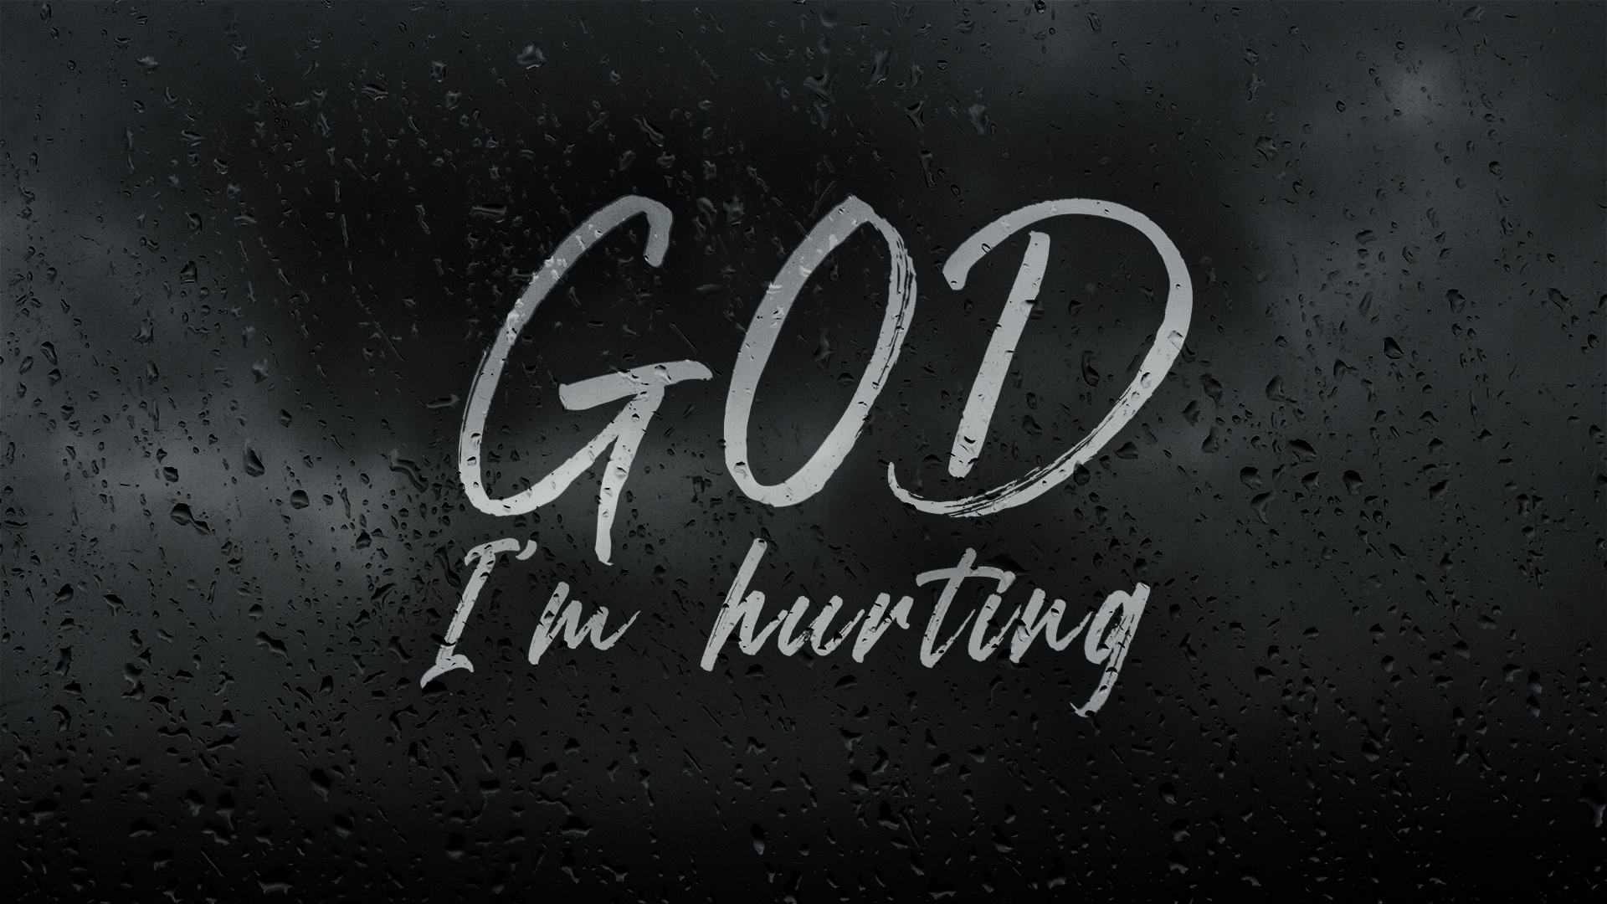

Slide 2
ROAD TRIP!
Share your most memorable road trip adventure with the group.
What part of it will you never forget?

Slide 3
GOD. I’M HURTING – BUT IT’S MY FAULT
On Sunday, Pete talked about how we can lament even from a place a guilt. We can lament even when the suffering and pain we feel is self-inflicted or the natural consequence of our sin.
What do you think of this idea?

Slide 4
LAMENTATIONS 3:1-24
Jeremiah uses some descriptive imagery to express his hurt and the hurting he sees all around him. Go back through verses 1-20 and write or speak out the imagery you find there.
Why is this imagery so powerful?
How might using imagery help you in forming your own lament?

Slide 5
LAMENTATIONS 3:1-24
In vs. 21-24 Jeremiah comes to a new point in his journey of lamenting.
What key words or ideas does Jeremiah use
to express this part of his journey?

Slide 6
JESUS – THE ANSWER TO OUR LAMENT
We lament, but we never give up.
READ: 2 Corinthians 4:14-18
In verse 14, what does Paul say we “know”?
Paul was well acquainted with hurting and lament, yet he has a unique perspective. He says, “For our present troubles are small and won’t last very long.” vs. 17 NLT
How can he say that?

Slide 7
JESUS – THE ANSWER TO OUR LAMENT
We lament, but we hold on to hope:
READ: Romans 8:24-26
What do these verses teach us about holding on to hope?

Slide 8
JESUS – THE ANSWER TO OUR LAMENT
We lament, but we don’t lose our joy
READ: 1 Peter 1:3-7
Why is it important to hang onto joy in our seasons of hurting?

Slide 9
JESUS – THE ANSWER TO OUR LAMENT
We lament from a place of victory
“O death, where is your victory? O death, where is your sting?”
1 Corinthians 15:55 NIV
How can lamenting from a place of victory change our perspective?

Slide 10
JESUS – THE ANSWER TO OUR LAMENT
We lament, but we anticipate glory.
“I consider that our present sufferings are not worth comparing with the glory that will be revealed in us.” Romans 8:18 NIV
What does it look like to anticipate glory,
even in our time of lamenting?

Slide 11
NEXT STEPS
Here are some websites of resources that can help you take a next step in processing hurt in your life.
Celebrate Recovery https://www.creeksidechurch.ca/celebrate-recovery/
Creekside Cares https://www.creeksidechurch.ca/care/
The Coping Centre https://www.copingcentre.com/

Slide 12
PRAYER
This week let’s pray for our high school and young adult ministries at Creekside.
Please pray for our high school student’s transition back to in-person learning, that God would guide them and keep them safe as they make this transition.
Please pray for our young adult’s mental health during this lockdown. Ask God to focus their hearts and minds on Him and his truths for their lives.

